Slide 1
The Middle Age (450 - 1450)
Kenny Lim

Slide 2
Music in the Middle Ages (450 - 1450)
During the Middle Ages, musicians worked for churches, courts, and towns.
Most medieval music was vocal, though musicians also performed on a wide variety of instrument.
After about year 1000, organs and bells become increasingly common in cathedrals and monastic churches.
Notes:
- Most important musicians were priests and worked for the church. - Woman are not allowed to sing in church but did make music in convents - Although instrument are used, but most music at this time were vocal - Only until about after year 1000, organs and bells slowly becoming more common in monastic churches

Slide 3
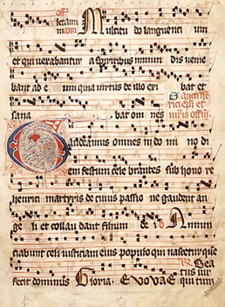
Gregorian Chant
Western Plaintchant
Sacred Music
Set to sacred Latin texts
Chant is in Monophonic Texture
Flexible rhythm, without meter, and little sense of beat.
Passed along by oral tradition

Slide 4
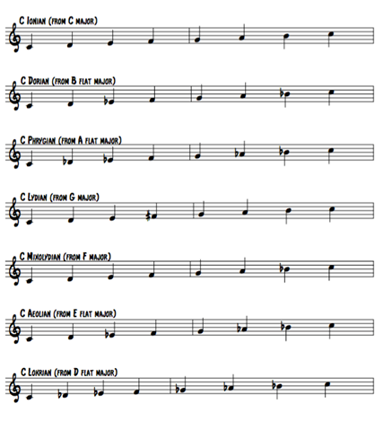
Church Modes
Also known as the Gregorian Modes
Started around 8th century
Churches in the Europe started to adopt these modes as a way to perform Gregorian chants.

Slide 5
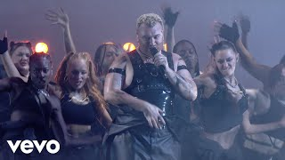

Slide 6
Characteristics of Gregorian Chant
Conveys a calm, otherworldly, spiritual quality
Composers were relatively uninterested in expressing emotions of a text
Melodies tends to move in steps

Slide 7
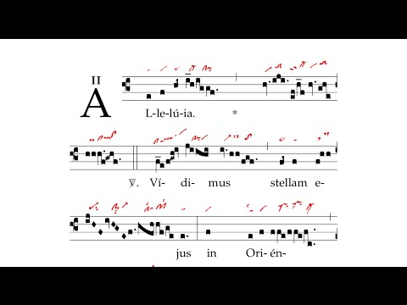
Alleluia: Vidimus Stellam
Latinized form of the Hebrew hallelujah (praise the lord)
Chant is in A – B – A form
Notes:
- Vidimus Stellam means “We have seen his star” - Lyrics: We have seen his star in the East, and we have come with our gifts, to worship the Lord. - Story about Jesus being born

Slide 8
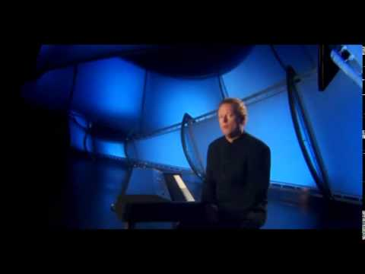
Introduction of Polyphonic textures
Gregorian chant that consists one or more additional melodic lines is called organum.

Slide 9
Secular Music in the Middle Ages
Troubadour and Trouvere Song
Songs indicates pitches but not rhythm
Either performed by their composer or wandering minstrels
Mostly about love and romance.
Woman troubadour are called Troubairitz
Notes:
- Secular music: non-religious music - Mostly of the secular music in the Middle Ages were composed by Troubadour, and woman are allowed to become a Troubadour, they are called Troubairitz. - So who can tell me what is Trouvere? A: Trouvere is the North French version of Troubadour; Troubadour and Troubairitz are from Southern France. - There are some scores left over by Troubadours, but these scores only indicates pitches without rhythm

Slide 10
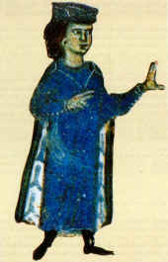
William IX, Duke of Aquitaine
The first Troubadour
A vernacular lyric poet in the Occitan language
Every joy must abase itself,
and every might obey
in the presence of Midons, for the sweetness of her welcome,
for her beautiful and gentle look;
and a man who wins to the joy of her love
will live a hundred years.
The joy of her can make the sick man well again,
her wrath can make a well man die,

Slide 11
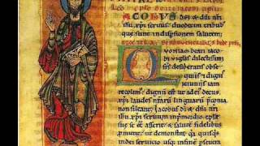

Slide 12

Estampie
Medieval dance
Single melodic line
Drone accompaniment parts
Scores does not specify instrumentation
Improvisation is used, performers might add drones - two simultaneous, repeated notes at the interval of a fifth, performed on a psaltery (a plucked or struck string instrument)

Slide 13
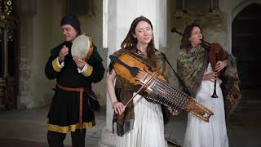

Slide 14
14th century:
The “New Art” in Italy and France
Early 14th century a new system of music notation had evolved, composers could specify almost any rhythmic pattern.
Syncopation became an important rhythmic practice.

Slide 15
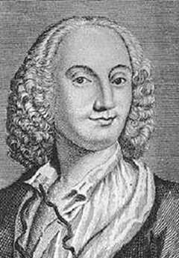
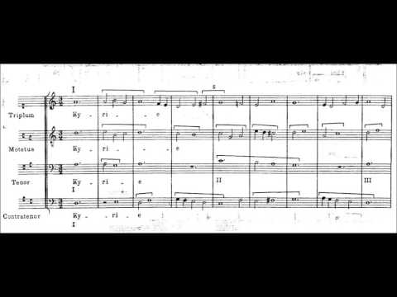
Guillaume de Machaut
French Poet and Composer
The first composer to compose a Polyphonic Mass setting
ARS Nova (New Art)

Slide 16
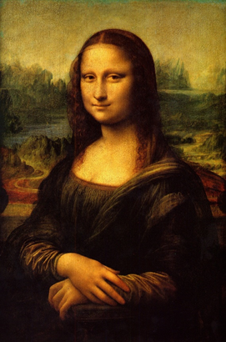
The Renaissance
Kenny Lim

Slide 17


What comes to your mind when you hear Renaissance period?
ⓘ
Click Present with Slido or install our Chrome extension to activate this poll while presenting.
Notes:
📣 This is Slido interaction slide, please don't delete it. ✅ Click on 'Present with Slido' and the poll will launch automatically when you get to this slide.

Slide 18
Characteristics
Vocal music was more important than instrumental music
Renaissance composers often used word painting, a musical depiction of specific words.
The wide range of emotion in Renaissance music is usually expressed in a moderate, balanced way, with NO extreme contrasts of dynamics, tone color or rhythm.
Texture is mainly Polyphonic

Slide 19
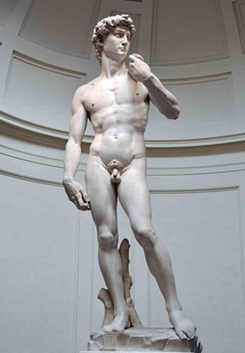
Bass register was used for the first time
No instrumental accompaniment
Special occasions where instruments were combined with voices, instrument might duplicate the vocal lines to reinforce the sound, or take the part of a missing singer.
Rhythm is a gentle flow rather than sharply defined beat.
Each line of music has great rhythmic independence.

Slide 20
Sacred Music in the Renaissance
Motet and Mass
Both are polyphonic choral works
Motet is set to a sacred Latin text other than ordinary mass
Renaissance Mass is made up of FIVE sections: Kyrie, Gloria, Credo, Sanctus and Agnus Dei.

Slide 21
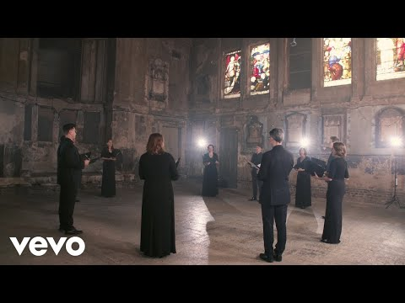
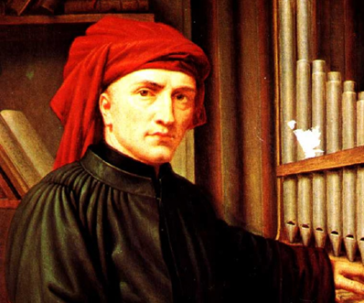
Josquin des Prez (1450 - 1521)
Ave Maria… virgo serena (Hail, Mary… serene virgin; c. 1475)
Central figure of High Renaissance style
Applied a freer and newer polyphonic composition technique, and showed modern sense of tonality.
Notes:
Applied a freer and newer polyphonic composition technique, and showed modern sense of tonality.
Listen to how the voices of individual parts are being presented, imitation among each voices.

Slide 22
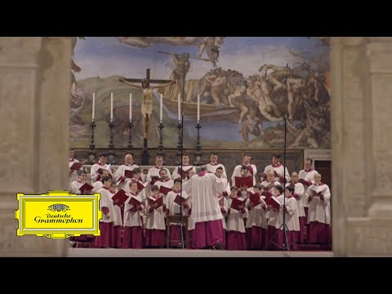
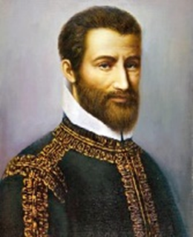
Giovanni Pierluigi da Palestrina
(1525 - 1563)
Pope Marcellus Mass - Kyrie

Slide 23
Secular Music in Renaissance
Every educated person was expected to play an instrument and read notation.
Madrigal became popular
Originated from Italy, popular in Spain and England
Secular voice music, several solo voices set to a short poem, usually about love.
Combines homophonic and polyphonic textures
Uses word painting and unusual harmonies more often

Slide 24
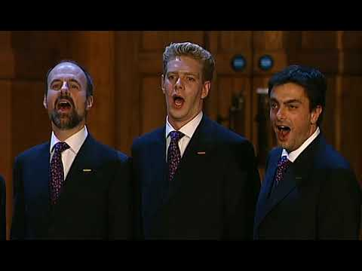
Thomas Weelkes (1575 - 1623)
As Vesta was from Latmos hill Descending
She spied a maiden queen the same ascending,
Attended on by all the shepherds swain,
To whom Diana’s darlings came running down amain.
First two by two,
Then three by three together,
Leaving their goddess all alone, hasted thither,
And mingling with the shepherds of their train
With mirthful tunes her presence entertain.
Then sang the shepherds and nymphs of Diana,
Long live fair Oriana!
Notes:
Three form of english madrigal: Madrigal proper, ballet, ayre

Slide 25
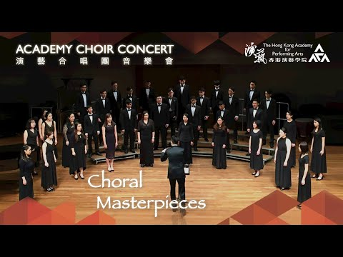
Thomas Morley (1557 - 1602)
Balett madrigal:
“In Renaissance England, they (fa-la) were used to advance a song’s satirical critique of society or as a lyrical surrogate for something that couldn’t be expressed explicitly.”
Notes:
Contributed foremost to the english madrigal development, where he modeled after italian madrigals.
In Renaissance England, they were used to advance a song’s satirical critique of society or as a lyrical surrogate for something that couldn’t be expressed explicitly.
Instead of word painting, the expressive part of the music is replaced with the lyric “fa-la”

Slide 26
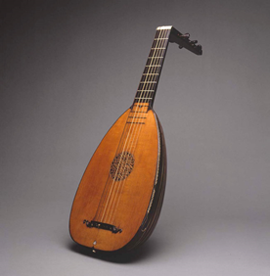
The Renaissance Lute Song
The lute, derives from the Arab instrument known as the ‘ūd (literally, the wood)
Plucked string instrument with a body shaped like half a pear
Due to it’s versatility, it is very popular in the Renaissance era.
English lute songs widely cultivated from the late 1590s – 1620s
Lute songs are mostly homophonic in texture

Slide 27
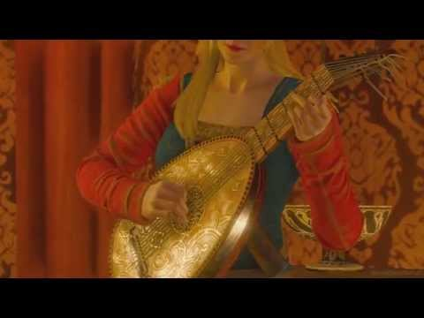

Slide 28
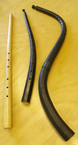
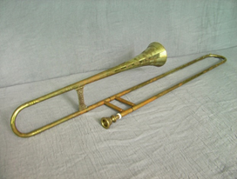
Instrumental music in Renaissance
Instrumental music are more intended for dancing
Every cultivated person was expected to be skilled in dance, which was taught by professional dancing masters.
Instruments produced a softer, less brilliant sounds.
Important Renaissance instruments were recorders, shawm, cornets, sackbuts, viols, organs, regals and harpsichord.

Slide 29
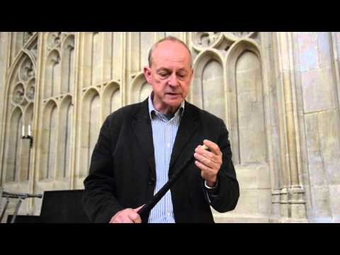
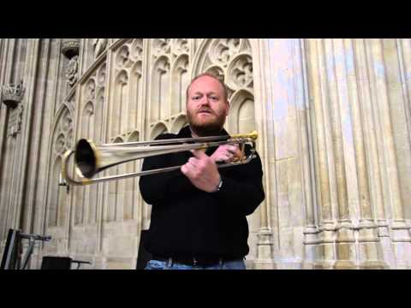
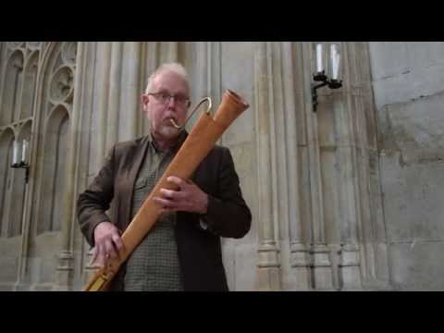
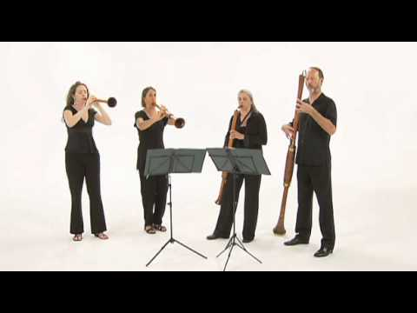

Slide 30
Renaissance Dance:
Passamezzo & Galliard
FORM
Passamezzo - AA BB CC ABC
Galliard – AA BB CC
Passamezzo: stately dance in duple meter
Galliard: quick dance in triple meter

Slide 31
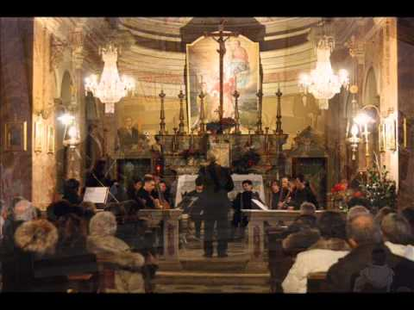

Slide 32
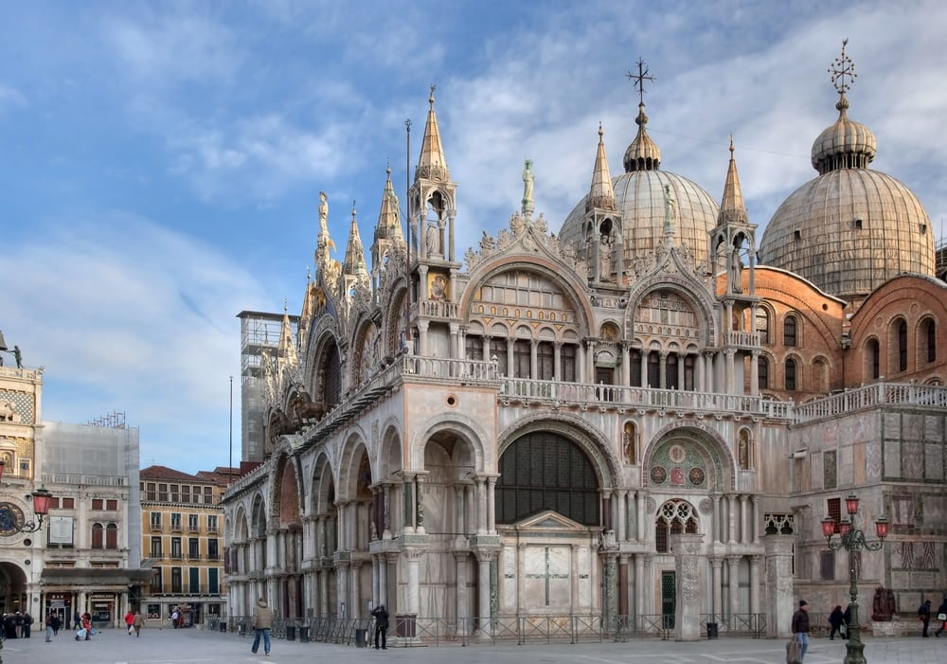
The Venetian School:
From Renaissance to Baroque
Venetian choral music of the late 16th century often contains parts that are written exclusively for instruments.
Early Baroque tendency towards homophonic texture

Slide 33
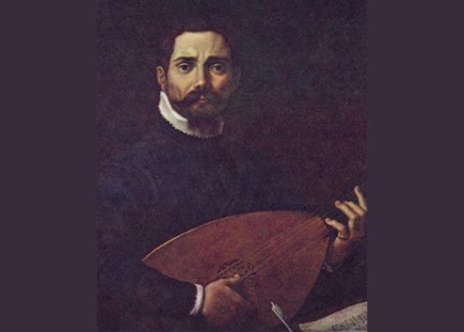
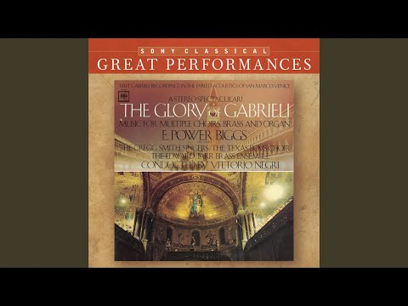
Giovanni Gabrieli (1556 - 1612)
Represents the culmination of Venetian School at the time during the shift of Renaissance to Baroque idioms.
Celebrated for his sacred works

Slide 34

What do you call music that is performed in Church?
ⓘ
Click Present with Slido or install our Chrome extension to activate this poll while presenting.
Notes:
📣 This is Slido interaction slide, please don't delete it. ✅ Click on 'Present with Slido' and the poll will launch automatically when you get to this slide.

Slide 35
Next: Baroque Period

